Slide 1
ENSE 471, Project Delivery
Group D
Jingkang Yang
Allan Wambold
Onisokien Ayonoadu
April 10th, 2020
Notes:
Wellcome, this is our ENSE 471 Project Delivery.
We are Group D

Slide 2
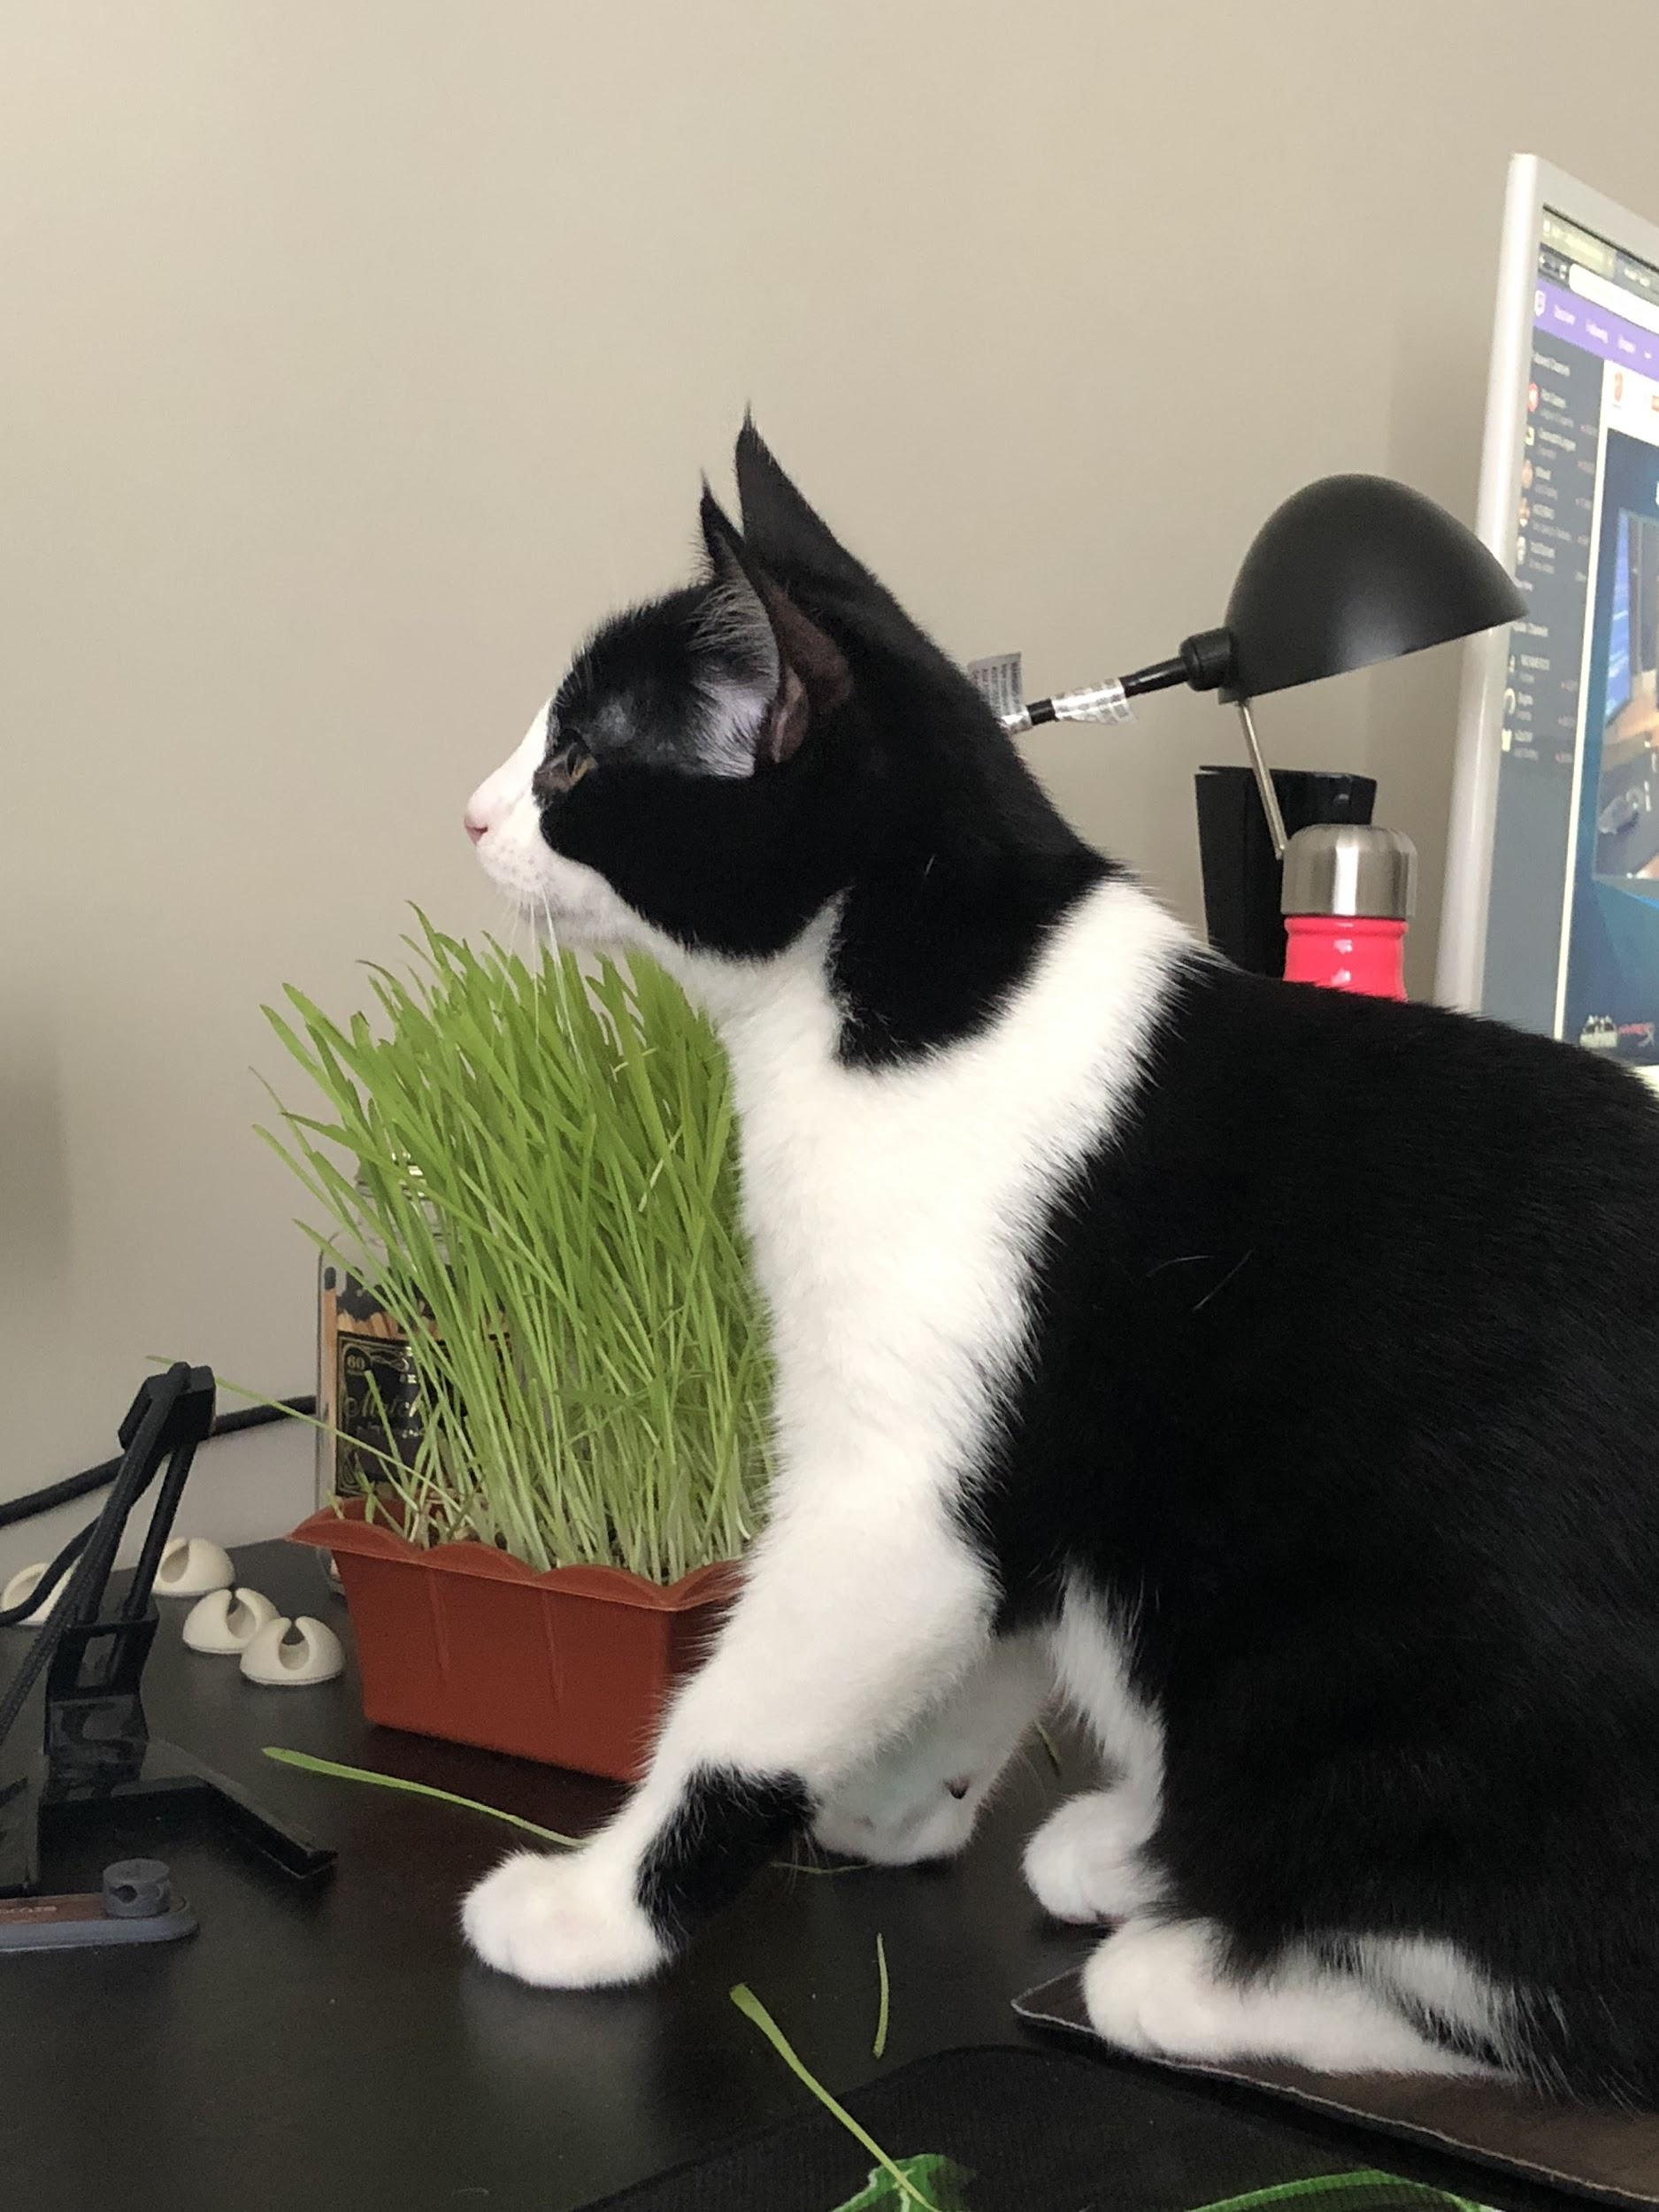
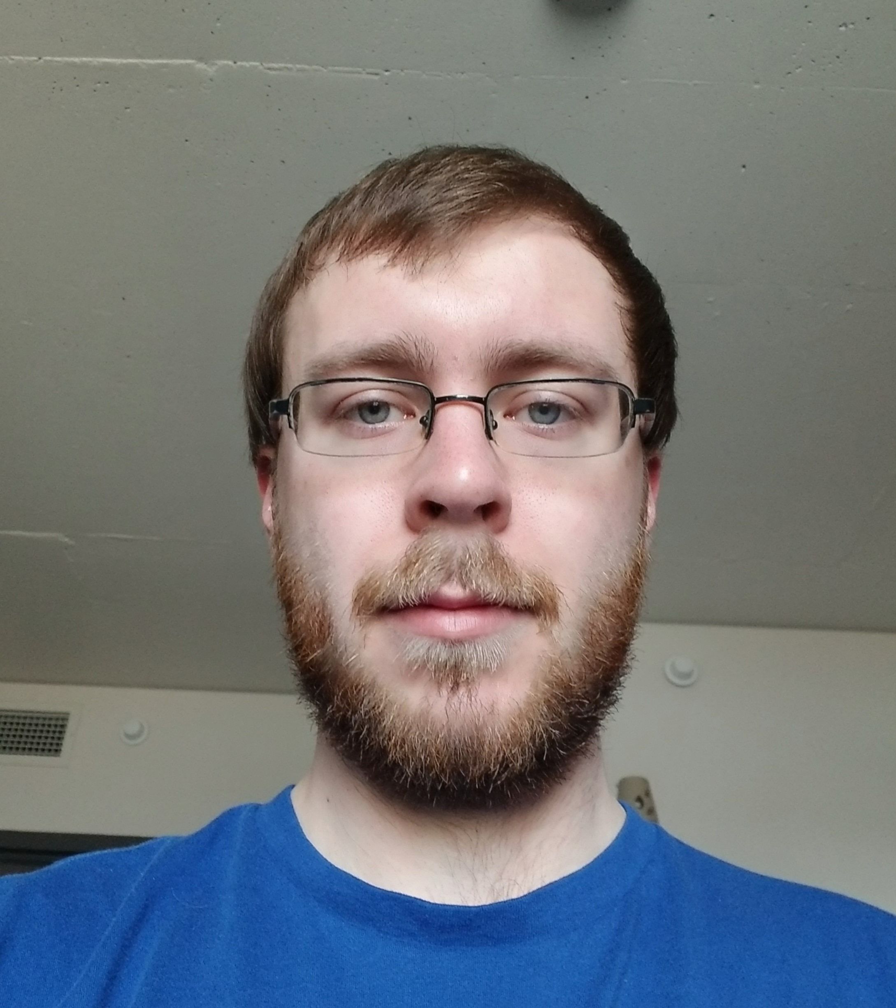
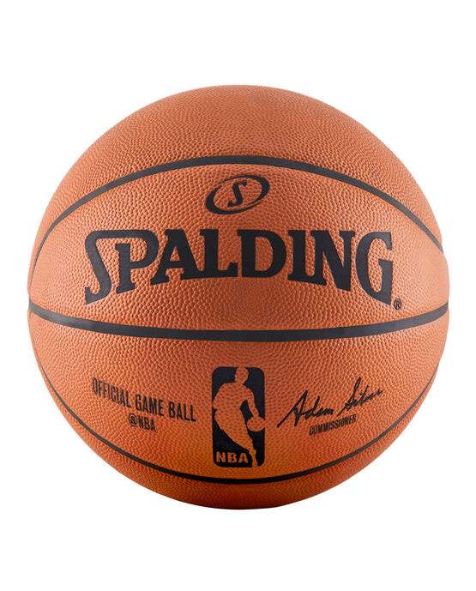
Team Introductions
Jingkang Yang
200362586
Allan Wambold
200375892
Onisokien Ayonoadu
200360422
Notes:
(Re)introduce your team and its members

Slide 3
Problem, requirements, & framing
Problem definition:
(Primary) As the technology found in the average household advances, fewer and fewer children understand how to use touch-tone phones.
(Secondary) The program only educates the children, the problem is the parents typically do not know any more about fire safety than the children do.
Project Vision:
Create a way of simulating a 911 phone call for demonstration purposes, and an easily accessible and friendly source of knowledge for the parents to become familiar with the information regarding fire safety.
Project Rationale:
Fires are by and large mostly preventable; by aiding programs that educate on fire, and fire safety to reach further, and educate more efficiently the number of unnecessary catastrophes can be reduced.
Notes:
Show your problem statement and provide a rationale as to how your team crafted it
Link back to affinity diagramming
Link back to initial empathy mapping

Slide 4
Problem, requirements, & framing (cont'd)
Stakeholders:
Regina Fire & Protective Services (RFPS), Children, Parents and other fire safety programs.
Assumptions:
Users have access to a phone, users speak English. RFPS has access to two phones so they can make use of the app, technologies are available.
Constraints:
Time, knowledge/experience on app development, getting parents to use the app.
High-level customer needs/requirements:
Customer needs a way of demonstrating a 911 phone call.
Customer needs a way to educate parents about fire safety.
Notes:
Show your problem statement and provide a rationale as to how your team crafted it
Link back to affinity diagramming
Link back to initial empathy mapping

Slide 5
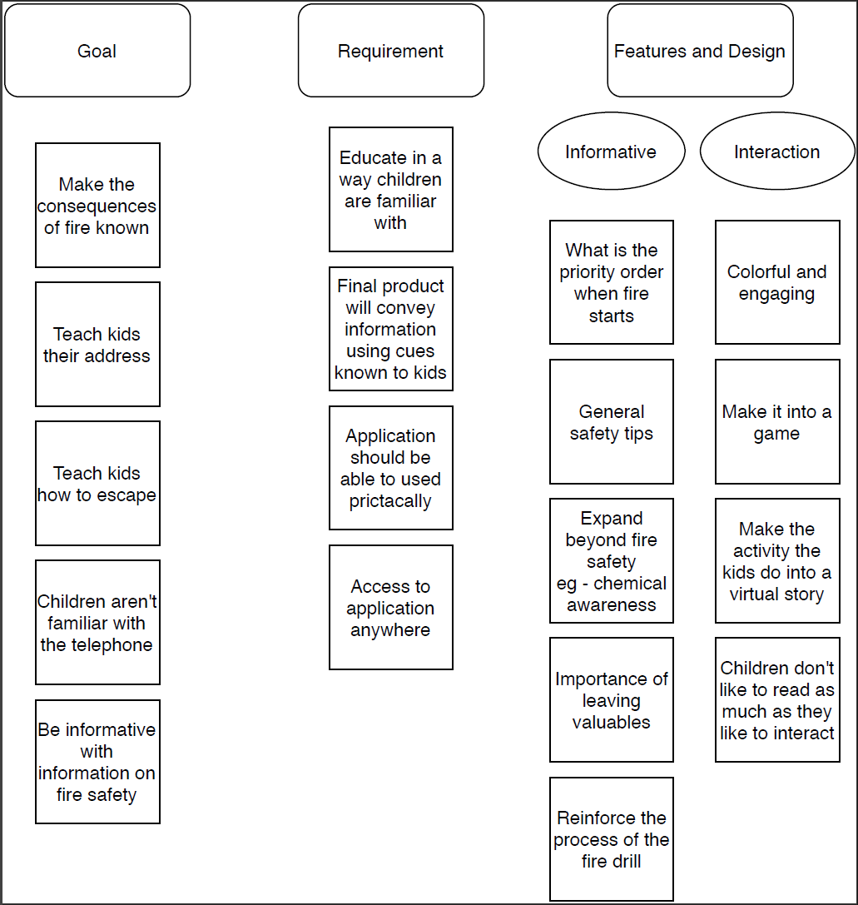
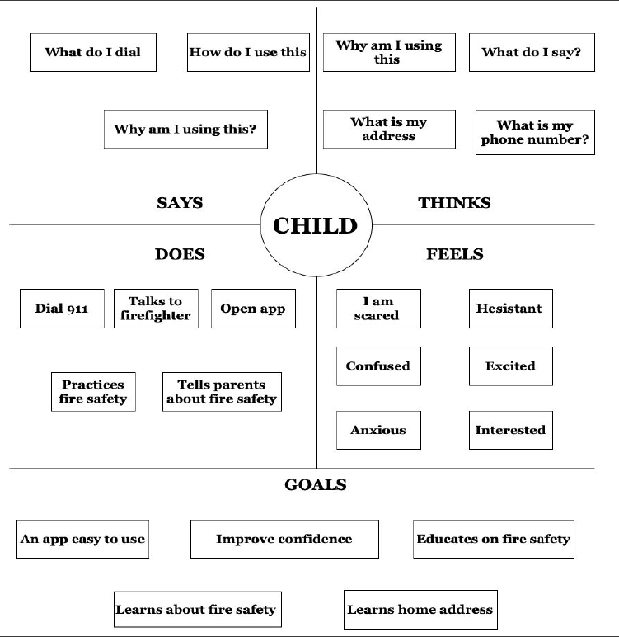
Problem, requirements, & framing (cont'd)
Affinity Diagram
Initial Empathy Mapping
Notes:
Show your problem statement and provide a rationale as to how your team crafted it
Link back to affinity diagramming
Link back to initial empathy mapping

Slide 6
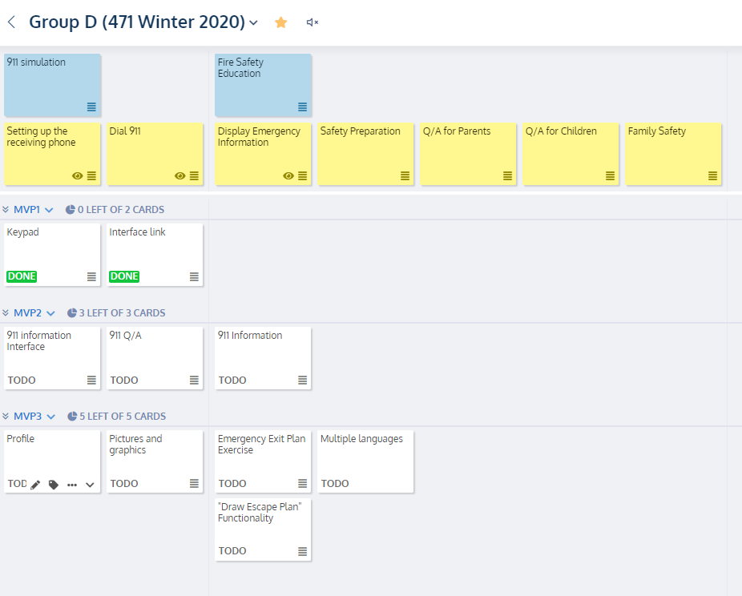
Problem, requirements, & framing (cont'd)
USM
Dev: MVP1
Keypad
Interface link
UAT: MVP2 (Future)
Rebuild 911 Interface
911 Q/A
911 Information
Prod: MVP3 (Future)
Profile
Pictures and graphics
Emergency Exit plan
Multiple language
Notes:
Illustrate your USM & MVP vision
Dev ("development" - the phase I expect teams to be at/submit, with partial testing as you've been partially testing with Candace all along). Things can be a little rough around the edges with a developed solution, but things should be near UAT form
UAT (User Acceptance Testing) - Testing a finished app with real customers. This is something we could have explored in this class with K-grade3 kids and firefighters but the logistics, not to mention what has happened with COVID-19 would have made this next to impossible
Prod (live, partial/full set of customers). Usually after one-to-several iterations of UAT, an app "goes-live"

Slide 7
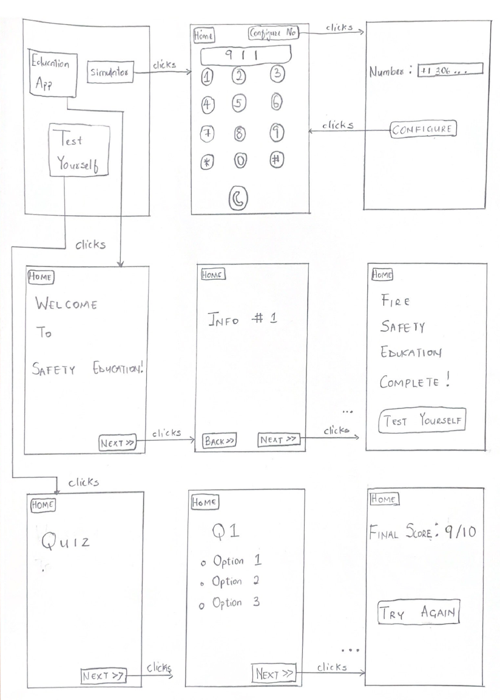
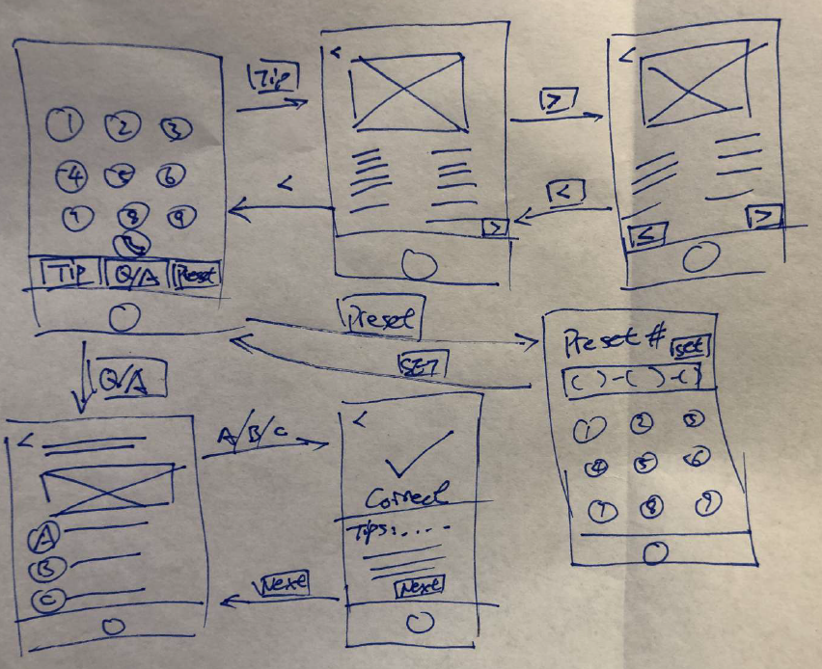
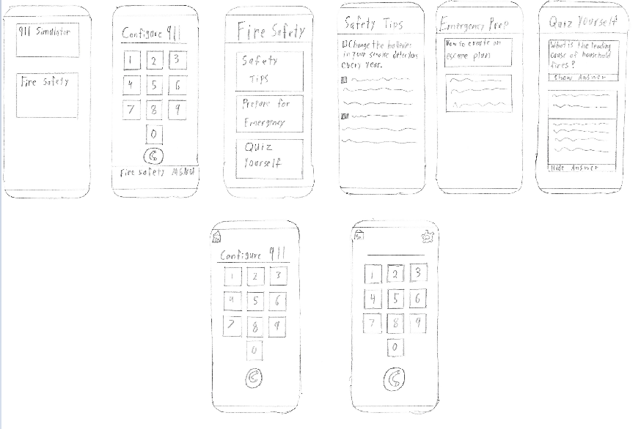
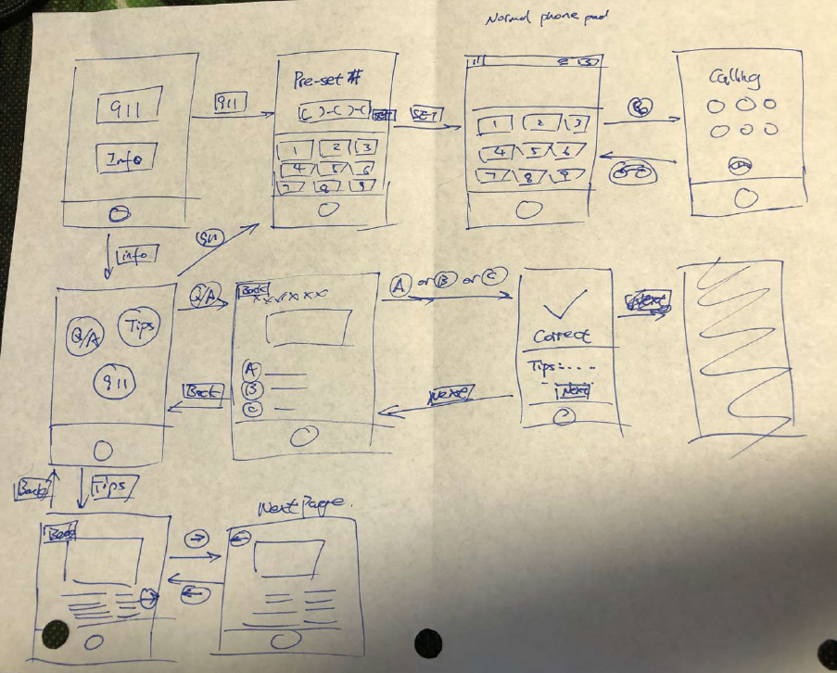
From lo-fidelity to hi-fidelity prototypes
Notes:
Illustrate your brainstorming and provide digital captures of the various lo-fidelity prototypes your team came up with
Discuss customer/team insights based on conversations with the key customer (Candace)
Ensure you link your design ideas back to a minimum of three topics discussed in class relating to people centered design (affordances, gestalt, constraints, etc.)

Slide 8
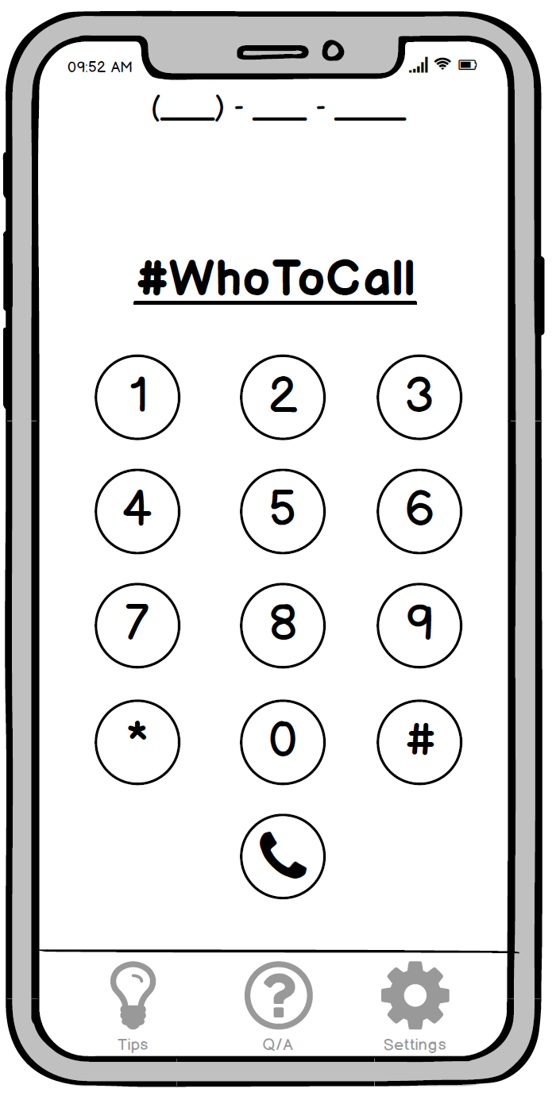
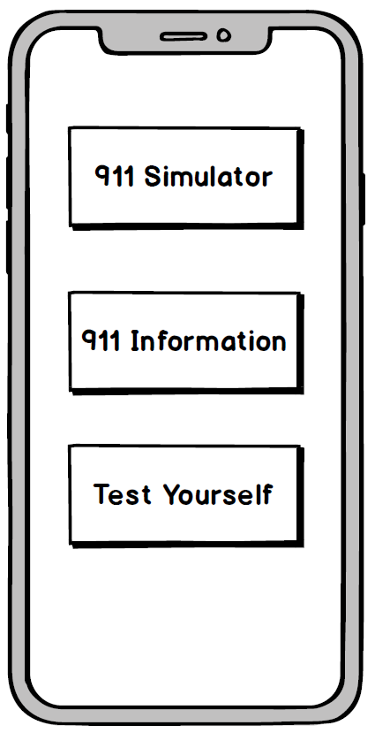
From lo-fidelity to hi-fidelity prototypes
Hi-fidelity 1
Hi-fidelity 2
Notes:
Illustrate your hi-fidelity prototype (in Balsamiq – simply provide screenshots/image captures or go through it in Balsamiq)
Discuss customer/team insights based on conversations with the key customer (Candace)
Ensure you link your design ideas back to a minimum of three topics discussed in class relating to people centered design (affordances, gestalt, constraints, etc.)

Slide 9
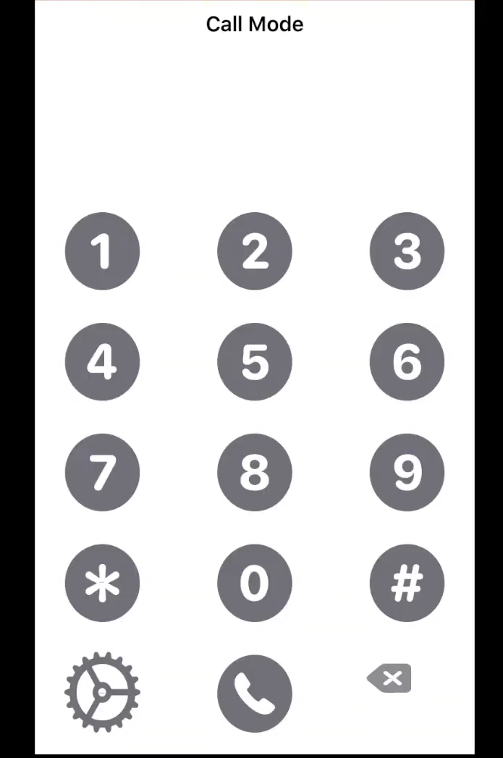
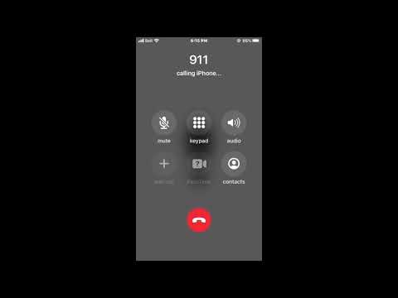
Solution demo
Notes:
Do a high-level overview of your solution, including screenshots of key experiences
Demo your solution
Discuss links to lo/hi-fidelity prototypes
Discuss experiences as they relate to your team’s USM/MVP
Again, ensure you link your design ideas back to a minimum of three topics discussed in class relating to people centered design (affordances, gestalt, constraints, etc.)

Slide 10
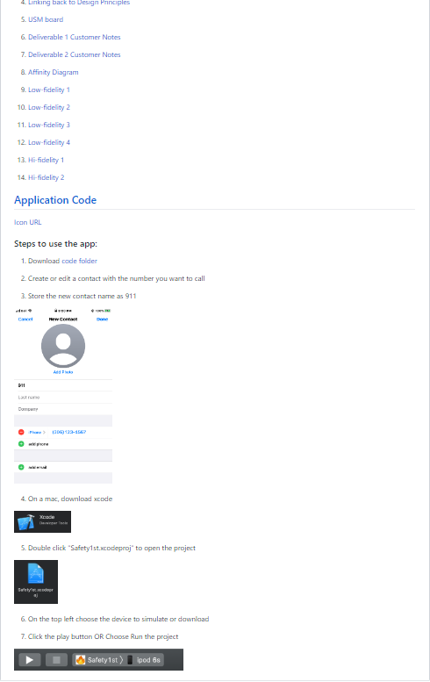
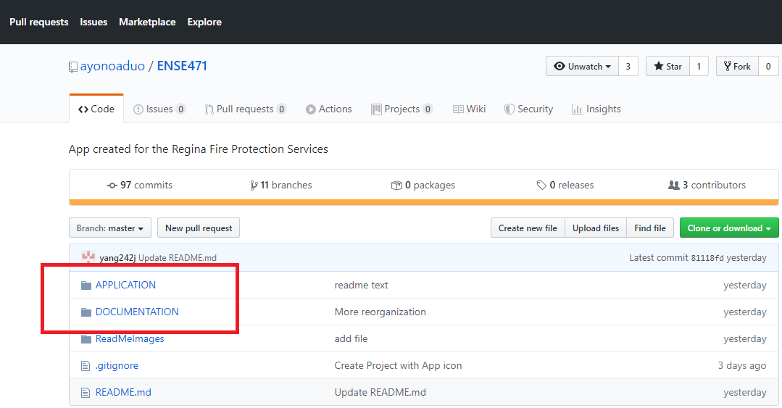
GitHub “stamp of approval”
GitHub Link : ayonoaduo/ENSE471
Notes:
Confirm that your team’s GitHub is up to date and user friendly (highly readable and understandable – see the Project Description and Key Deliverables document in URCourses)
NOTE: No need to spend too much time here – do a quick overview and provide your stamp of approval

Slide 11
Group reflection
How did you feel about this project? What did you like about it? What did you dislike?
We liked that this project taught us about user interface design and what it means to work with a real customer.
We disliked how the project coding time felt short, and sometimes we felt lost in how to move forward in our project.
What did you learn about yourself as you collaborated and worked through this project?
Nobody is perfect, some of us are better at coding, some are better with design.
How will you use what you have learned on this project going forward?
This project required the learning and use of skill sets in multiple areas in design and collaboration, which we believe will be useful tools moving forwards regardless of what future projects we take on.

